Slide 1
JargonEasy
Explains it all

Slide 2



Slide 3
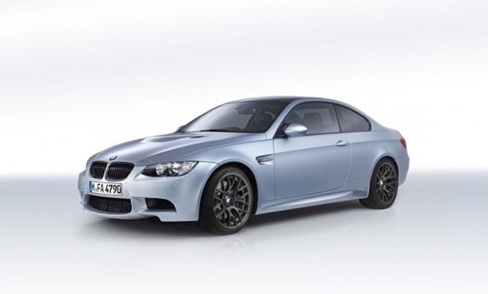
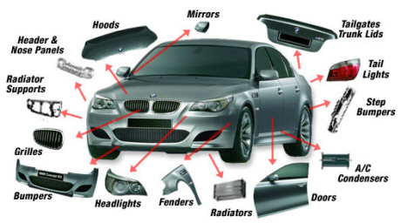
Enjoy the car buying experience by being informed!

Slide 4

What are they talking about???

Slide 5

JargonEasy explains it all!

Slide 6
What is ESC?
ESC
Electronic stability control, or "ESC." A safety feature that improves the safety of a vehicles handling by detecting skids and compensating by adjusting braking pressure to help maintain the intended direction of the vehicle. Some stability control systems also reduce engine power until control is regained.

Slide 7
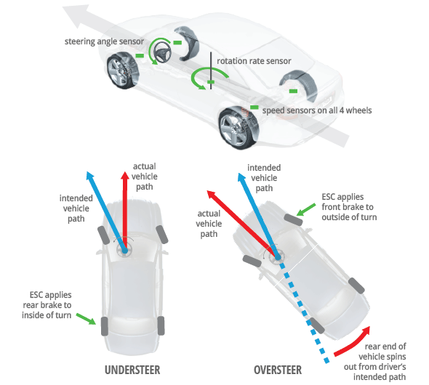
What is ESC?
.

Slide 8

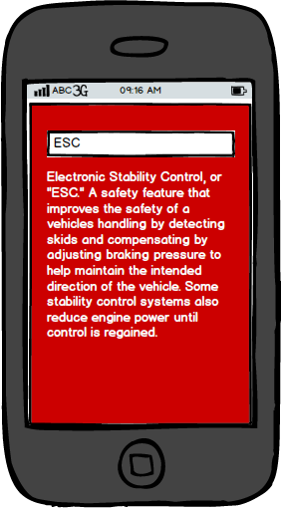


Mobile App
JargonEasy
Explains It All

Slide 9
JargonEasy
plain and simple

